Slide 1
Big Data Open Source Software and Projects
Data Access Patterns and
Introduction to using HPC-ABDS
I590 Data Science Curriculum
August 16 2014
Geoffrey Fox
gcf@indiana.edu
http://www.infomall.org
School of Informatics and Computing
Digital Science Center
Indiana University Bloomington

Slide 2
HPC-ABDS

Slide 3
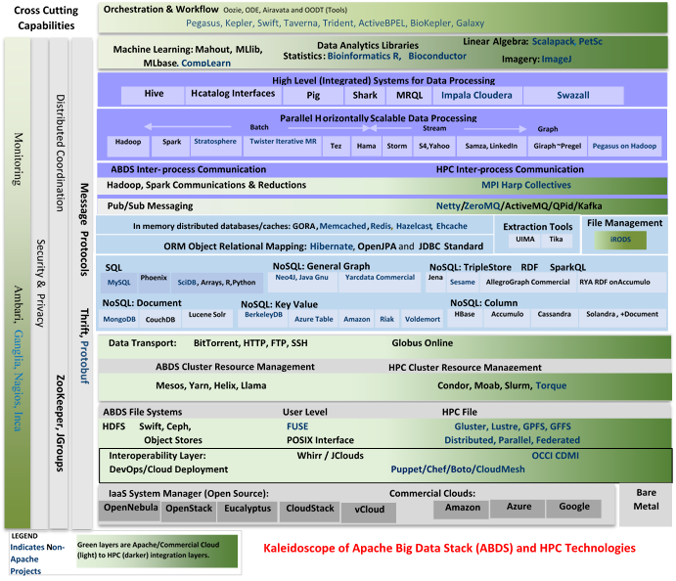
HPC-ABDS
~120 Capabilities
>40 Apache
Green layers have strong HPC Integration opportunities
Goal
Functionality of ABDS
Performance of HPC
Important Caveat: I will discuss ALL applications as though they used HPC-ABDS whereas in practice very few of them do as their software was developed before the current cloud revolution

Slide 5
TYPICAL DATA INTERACTION SCENARIOS
These consist of multiple data systems including classic DB, streaming, archives, Hive, analytics, workflow and different user interfaces (events to visualization)
From Bob Marcus (ET Strategies) http://bigdatawg.nist.gov/_uploadfiles/M0311_v2_2965963213.pdf
We list 10 and then go through each (of 10) in more detail. These slides are based on those produced by Bob Marcus at link above

Slide 6
10 Generic Data Processing
Use Cases
Multiple users performing interactive queries and updates on a database with basic availability and eventual consistency (BASE = (Basically Available, Soft state, Eventual consistency) as opposed to ACID = (Atomicity, Consistency, Isolation, Durability) )
Perform real time analytics on data source streams and notify users when specified events occur
Move data from external data sources into a highly horizontally scalable data store, transform it using highly horizontally scalable processing (e.g. Map-Reduce), and return it to the horizontally scalable data store (ELT Extract Load Transform)
Perform batch analytics on the data in a highly horizontally scalable data store using highly horizontally scalable processing (e.g MapReduce) with a user-friendly interface (e.g. SQL like)
Perform interactive analytics on data in analytics-optimized database
Visualize data extracted from horizontally scalable Big Data store
Move data from a highly horizontally scalable data store into a traditional Enterprise Data Warehouse (EDW)
Extract, process, and move data from data stores to archives
Combine data from Cloud databases and on premise data stores for analytics, data mining, and/or machine learning
Orchestrate multiple sequential and parallel data transformations and/or analytic processing using a workflow manager

Slide 7



1. Multiple users performing interactive queries and updates on a database with basic availability and eventual consistency
Generate a SQL Query
Process SQL Query (RDBMS Engine, Hive, Hadoop, Drill)
Data Storage: RDBMS, HDFS, Hbase
Data, Streaming, Batch …..
Includes access to traditional ACID database

Slide 8
2. Perform real time analytics on data source streams and notify users when specified events occur
Specify filter
Filter Identifying Events
Fetch streamed Data
Post Selected Events
Streaming Data
Posted Data
Identified Events
Streaming Data
Streaming Data
Archive
Repository
Storm, Kafka, Hbase, Zookeeper

Slide 9

3. Move data from external data sources into a highly horizontally scalable data store, transform it using highly horizontally scalable processing (e.g. Map-Reduce), and return it to the horizontally scalable data store (ELT)
Transform with Hadoop, Spark, Giraph …
Enterprise
Data
Warehouse
Data Storage: HDFS, Hbase
OLTP Database
Streaming Data
Web Services
ETL is Extract Load Transform
http://www.dzone.com/articles/hadoop-t-etl

Slide 10
4. Perform batch analytics on the data in a highly horizontally scalable data store using highly horizontally scalable processing (e.g MapReduce) with a user-friendly interface (e.g. SQL like)
SQL Query General Analytics
HCatalog
Hive
Mahout, R
Hadoop, Spark, Giraph, Pig …
Data Storage: HDFS, Hbase
Data, Streaming, Batch …..

Slide 11
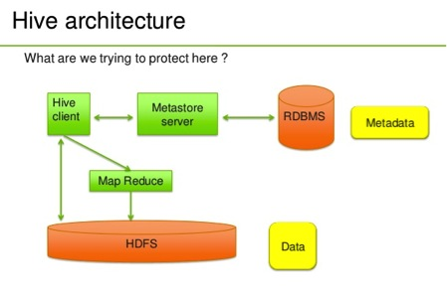
Hive Example
http://venublog.com/2013/07/16/hadoop-summit-2013-hive-authorization/

Slide 12
5. Perform interactive analytics on data in analytics-optimized database
Similar to 4 which is batch
Mahout, R
Hadoop, Spark, Giraph, Pig …
Data Storage: HDFS, Hbase
Data, Streaming, Batch …..

Slide 13
Science EXAMPLES

Slide 14
5A. Perform interactive analytics on observational scientific data
Science Analysis Code, Mahout, R
Grid or Many Task Software, Hadoop, Spark, Giraph, Pig …
Data Storage: HDFS, Hbase, File Collection
Direct Transfer
Transport batch of data to primary analysis data system
Streaming Twitter data for Social Networking
Local Accumulate and initial computing
Following examples are LHC, Remote Sensing, Astronomy and Bioinformatics
Record Scientific Data in “field”

Slide 15
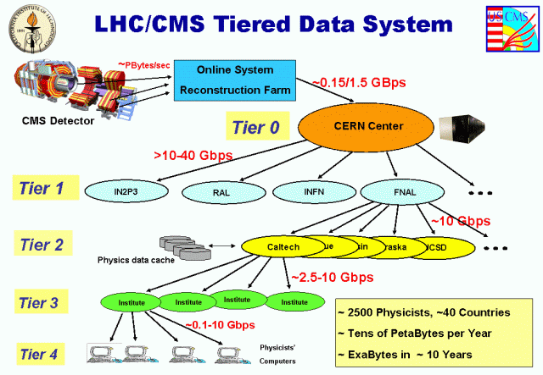
Particle Physics (LHC)
LHC Data analyzes ~30 petabytes of data per year produced at CERN using ~300,000 cores around the world
Data reduced in size, replicated and looked at by physicists

Slide 16
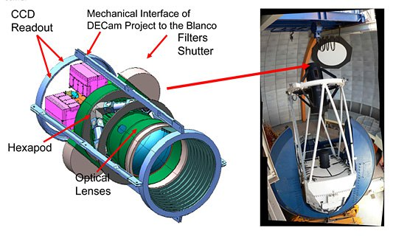
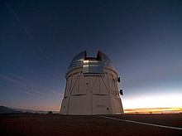
Astronomy – Dark Energy Survey I
Victor M. Blanco Telescope Chile where new wide angle 520 mega pixel camera DECam installed
https://indico.cern.ch/event/214784/session/5/contribution/410
Ends up as part of International Virtual observatory (IVOA), which is a collection of interoperating data archives and software tools which utilize the internet to form a scientific research environment in which astronomical research programs can be conducted.

Slide 17
Astronomy – Dark Energy Survey II
For DES (Dark Energy Survey) the data are sent from the mountaintop via a microwave link to La Serena, Chile. From there, an optical link forwards them to the NCSA (UIUC) as well as NERSC (LBNL) for storage and "reduction”. Here galaxies and stars in both the individual and stacked images are identified, catalogued, and finally their properties measured and stored in a database.
DES Machine room at NCSA

Slide 18
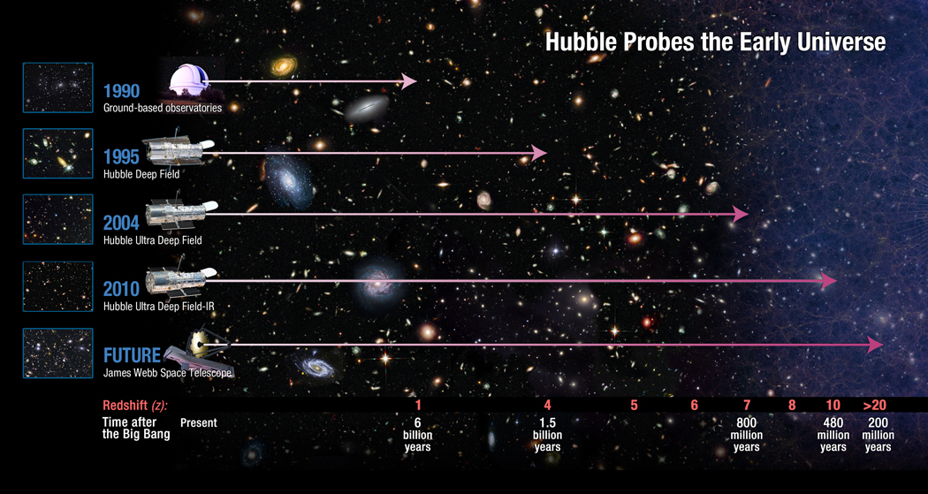
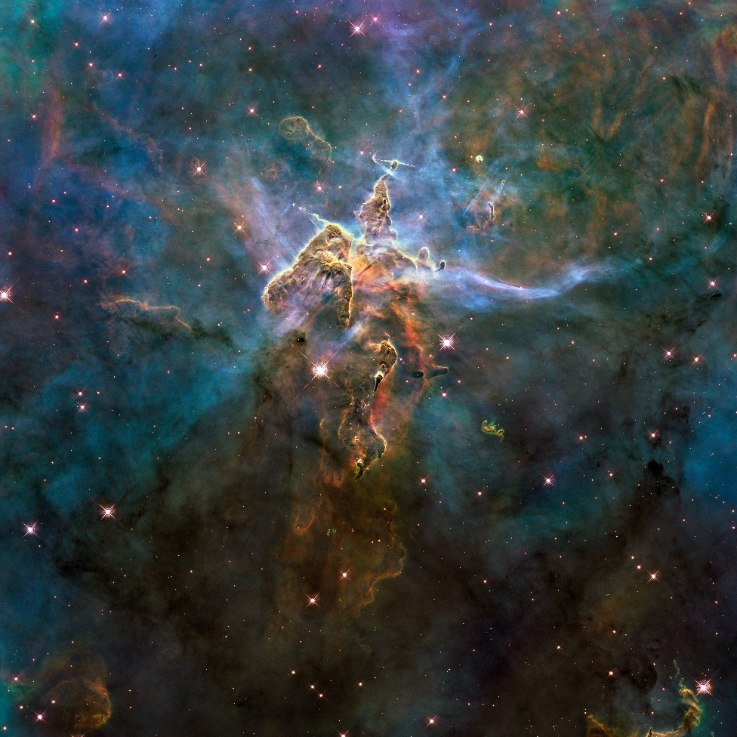
Astronomy
Hubble
Space Telescope
HST Processing in Baltimore Md
http://asd.gsfc.nasa.gov/archive/hubble/a_pdf/news/facts/FS14.pdf

Slide 19
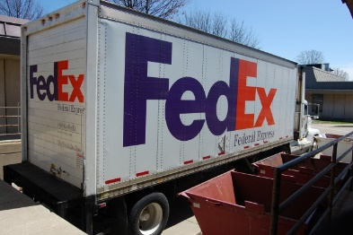
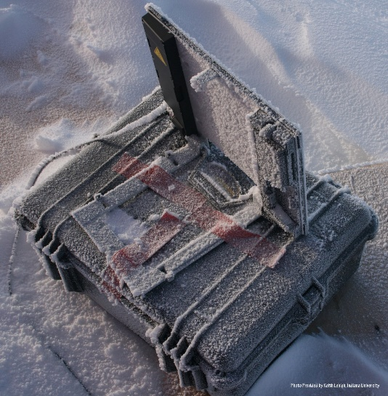
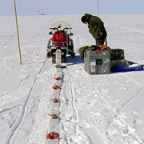
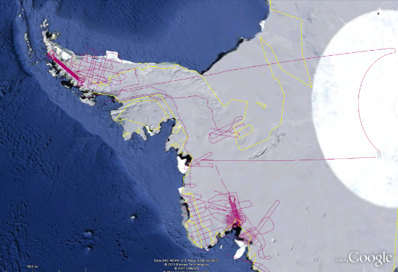
CReSIS Remote Sensing: Radar Surveys
Expeditions last 1-2 months and gather up to 100 TB data. Most is saved on removable disks and flown back to continental US at end. A sample is analyzed in field to check instrument

Slide 20
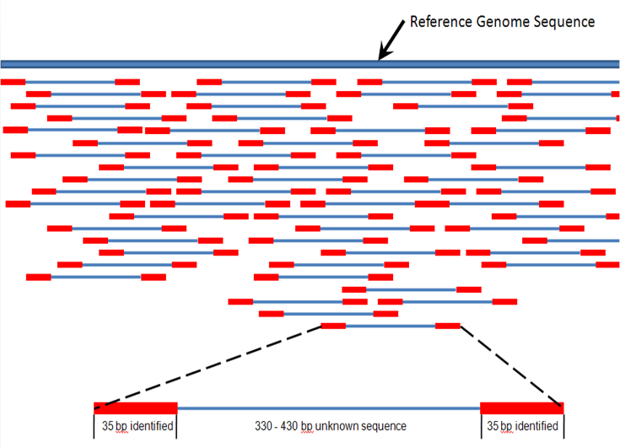
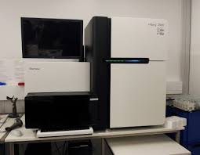
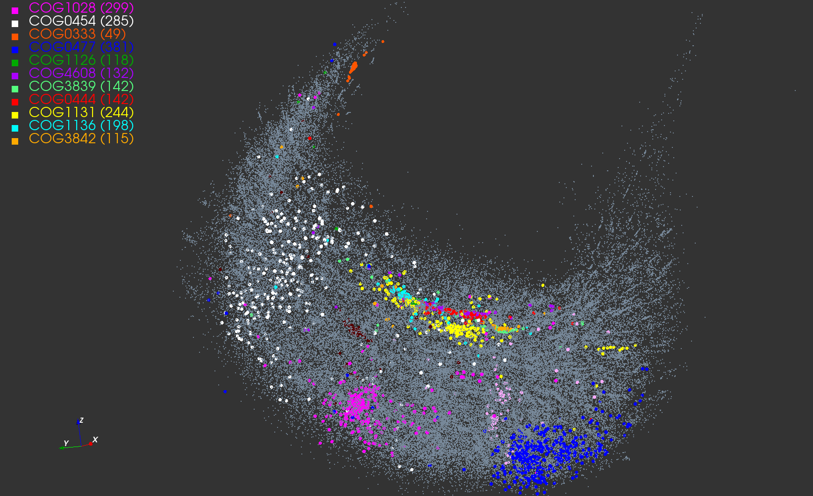
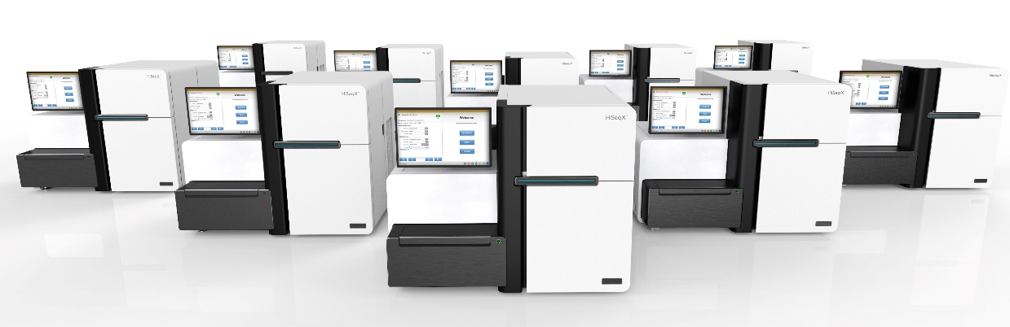
Gene Sequencing
Distributed (Illumina) devices distributed across world in many laboratories take data in form of “reads” that are aligned into a full sequence
This processing often local but data needs to be compared with world’s other gene so uploaded to central repository
Illumina HiSeq X 10 can sequence 18,000 genomes per year at $1000 each. Produces 0.6Terabases per day

Slide 21
Remaining general access patterns

Slide 22
6. Visualize data extracted from horizontally scalable Big Data store
Interactive Visualization
Specify Analytics
Orchestration Layer
Prepare Interactive Visualization
Mahout, R
Hadoop, Spark, Giraph, Pig …
Data Storage: HDFS, Hbase

Slide 23
7. Move data from a highly horizontally scalable data store into a traditional Enterprise Data Warehouse
Data Warehouse Query
Enterprise
Data
Warehouse
Transform with Hadoop, Spark, Giraph …
Data Storage: HDFS, Hbase, (RDBMS)
OLTP Database
Streaming Data
Web Services

Slide 24
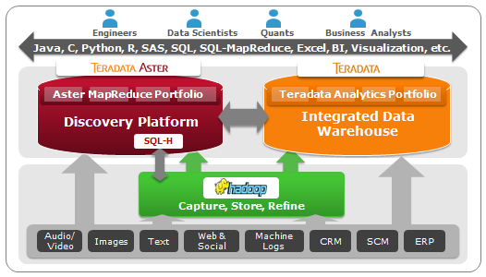
Moving to EDW Example from Teradata
Moving data from HDFS to Teradata Data Warehouse and Aster Discovery Platform
http://blogs.teradata.com/data-points/announcing-teradata-aster-big-analytics-appliance/

Slide 25

8. Extract, process, and move data from data stores to archives
Transform as needed
Transform with Hive, Drill, Hadoop, Spark, Giraph, Pig …
Data Storage: HDFS, Hbase, RDBMS
Archive
OLTP Database
Streaming Data
Web Services
ETL is Extract Load Transform
http://www.dzone.com/articles/hadoop-t-etl

Slide 26
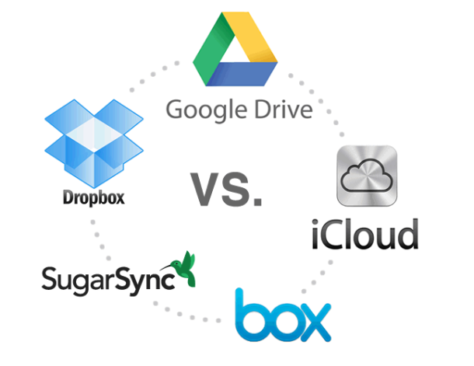
9. Combine data from Cloud databases and on premise data stores for analytics, data mining, and/or machine learning
Mahout, R
Similar to 4 and 5
Hadoop, Spark, Giraph, Pig …
Data Storage: HDFS, Hbase
On premise Data
Streaming Data

Slide 27
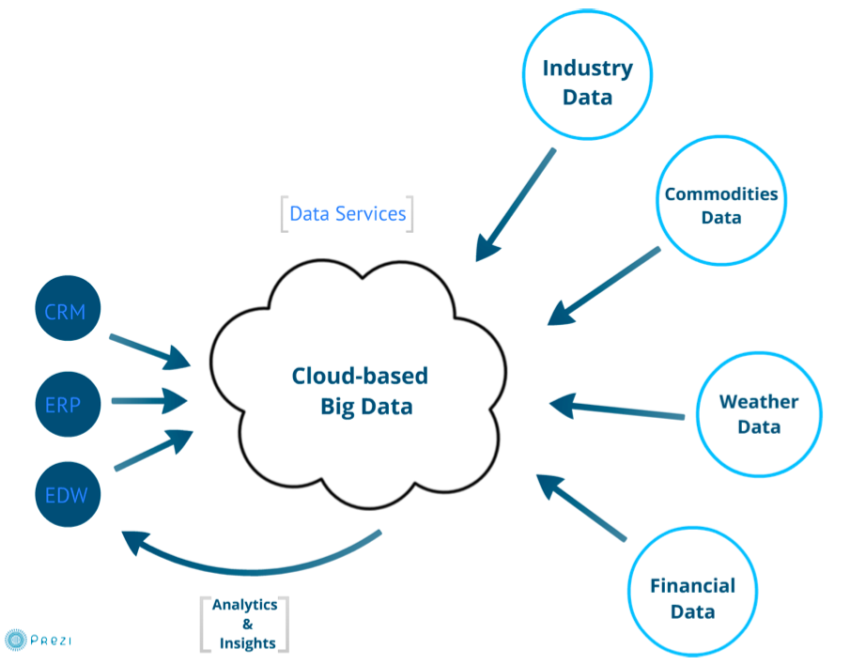
Example: Integrate Cloud and local data
http://wikibon.org/w/images/2/20/Cloud-BigData.png

Slide 28
10. Orchestrate multiple sequential and parallel data transformations and/or analytic processing using a workflow manager
This can be used for science by adding data staging phases as in case 5A
Specify Analytics Pipeline
Orchestration Layer (Workflow)
Analytic-3
(Visualize)
Analytic-2
Analytic-1
Hadoop, Spark, Giraph, Pig …
Data Storage: HDFS, Hbase

Slide 29
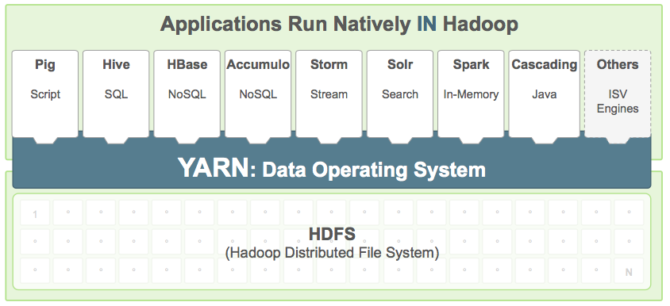
Example from Hortonworks
http://hortonworks.com/hadoop/yarn/

Slide 30
Using the HPC-ABDS Stack

Slide 31
Typical Usage Model of HPC-ABDS Layers
Message Protocols
Distributed Coordination:
Security & Privacy:
Monitoring:
IaaS Management from HPC to hypervisors:
DevOps:
Interoperability
File systems:
Cluster Resource Management:
Data Transport:
SQL / NoSQL / File management:
In-memory databases&caches / Object-relational mapping / Extraction Tools
Inter process communication Collectives, point-to-point, publish-subscribe
Basic Programming model and runtime, SPMD, Streaming, MapReduce, MPI:
High level Programming:
Application and Analytics:
Workflow-Orchestration:
Here are 17 functionalities. Lets discuss how these are used in particular applications
4 Cross cutting at top
12 in order of layered diagram starting at bottom

Slide 32
Using HPC-ABDS Layers I
Message Protocols
This layer is unlikely to seen in many applications as used in “underlying system”. Thrift and Protobuf have similar functionality and are used to build messaging protocols between components (services) of system
Distributed Coordination
Zookeeper is likely to be used in many applications as it is way that one achieves consistency in distributed systems – especially in overall control logic and metadata. It is for example used in Apache Storm to coordinate distributed streaming data input with multiple servers ingesting data from multiple sensors.
JGroups is less commonly used and is very different. It builds secure multi-cast messaging with a variety of transport mechanisms.
Security & Privacy I
This is of course a huge area present implicitly or explicitly in all applications. It covers authentication and authorization of users and the security of running systems. In the Internet there are many authentication systems with sites often allowing you to use Facebook, Microsoft , Google etc. credentials. InCommon, operated by Internet2, federates research and higher education institutions, in the United States with identity management and related services.

Slide 33
Using HPC-ABDS Layers II
Security & Privacy II
LDAP is a simple database (key-value) forming a set of distributed directories recording properties of users and resources according to X.500 standard. It allows secure management of systems. OpenStack Keystone is a role-based authorization and authentication environment to be used in OpenStack private clouds.
Monitoring:
Here Ambari is aimed at installing and monitoring Hadoop systems. Nagios and Ganglia are similar system monitors with ability to gather metrics and produce alerts. Inca is a higher level system allowing user reporting of performance of any sub system. Essentially all systems use monitoring but most users do not add custom reporting.
IaaS Management from HPC to hypervisors:
These technologies underlie all your applications. The classic technology OpenStack manages virtual machines and associated capabilities such as storage and networking. The commercial clouds have their own solution and it is possible to move machine images between these different environments. As a special case there is “bare-metal” i.e. the null hypervisor.

Slide 34
Using HPC-ABDS Layers III
DevOps
This describes technologies and approaches that automate the deployment and installation of software systems and underlies “software-defined systems”. We will integrate tools together in Cloudmesh – Libcloud, Cobbler, Chef, Docker, Slurm, Ansible, Puppet. Celery. Everybody will use this
Interoperability
This is both standards and interoperability libraries for services (Whirr), compute (OCCI), virtualization and storage (CDMI)
File systems
You will use files in any application but the details may not be visible to application. Maybe you interact with data at level of a data management system or an Object store (OpenStack Swift or Amazon S3). Most science applications are organized around files; commercial systems at a higher level.
Cluster Resource Management
You will certainly need cluster management in your application although often this is provided by the system and not explicit to the user. Yarn from Hadoop is gaining in popularity while Slurm is a basic HPC system as are Moab, SGE, OpenPBS and Condor also well known for scheduling of Grid applications. Mesos is similar to Yarn but appears less mature at present.

Slide 35
Using HPC-ABDS Layers IV
Data Transport
Globus Online or GridFTP is dominant system in HPC community but this area is often not highlighted as often application only starts after data has made its way to disk of system to be used. Simple HTTP protocols are used for small data transfers while the largest ones use the “Fedex/UPS” solution of transporting disks between sites.
SQL / NoSQL / File management
This is a critical area for nearly all applications as it captures areas of file, object, NoSQL and SQL data management. The many entries in area testify to variety of problems (graphs, tables, documents, objects) and importance of efficient solution. Just a little while ago, this area was dominated by SQL databases and file managers.
In-memory databases&caches / Object-relational mapping / Extraction Tools
This is another important area addressing two points. Firstly conversion of data between formats and secondly enabling caching to put as much processing as possible in memory. This is an important optimization with Gartner highlighting this areas in several recent hype charts with In-Memory DBMS and In-Memory Analytics.

Slide 36
Using HPC-ABDS Layers V
Inter process communication Collectives, point-to-point, publish-subscribe
This describes the different communication models used by the systems in layers 13, 14) below. Your results may be very sensitive to choices here as there are big differences from disk-based versus point to point for Hadoop v. Harp or the different latencies exhibited by publish-subscribe systems. Your results will reflect higher level system chosen
Basic Programming model and runtime, SPMD, Streaming, MapReduce, MPI
A very important layer defining the cloud (HPC-ABDS) programming model. Includes Hadoop and related tools Spark, Twister, Stratosphere, Hama (iterative MapReduce); Giraph, Pregel, Pegasus (Graphs); Storm, S4, Samza (Streaming); Tez (workflow and Yarn integration). You are bound to use something here!
High level Programming
Components at this level are not required but are very interesting and we can expect great progress to come both in improving them and using them. Pig and Sawzall offer data parallel programming models; Hive, HCatalog, Shark, MRQL, Impala, and Drill support SQL interfaces to MapReduce, HDFS and Object stores

Slide 37
Using HPC-ABDS Layers VI
Application and Analytics
This is the “business logic” of application and where you find machine learning algorithms like clustering. Mahout , MLlib , MLbase are in Apache for Hadoop and Spark processing; R is a central library from statistics community. There are many other important libraries where we mention those in deep learning (CompLearn), image processing (ImageJ), bioinformatics (Bioconductor) and HPC (Scalapack and PetSc). You will nearly always need these or other software at this level
Workflow-Orchestration
This layer implements orchestration and integration of the different parts of a job. These can be specified by a directed data-flow graph and often take a simple pipeline form illustrated in “access pattern” 10 shown earlier. This field was advanced significantly by the Grid community and the systems are quite similar in functionality although their maturity and ease of use can be quite different. The interface is either visual (link programs as bubbles with data flow) or as an XML or program (Python) script.

Slide 38
Some Especially Important or Illustrative HPC-ABDS Software
Workflow: Python or Kepler
Data Analytics: Mahout, R, ImageJ, Scalapack
High level Programming: Hive, Pig
Parallel Programming model: Hadoop, Spark, Giraph (Twister4Azure, Harp), MPI; Storm, Kapfka or RabbitMQ (Sensors)
In-memory: Memcached
Data Management: Hbase, MongoDB, MySQL or Derby
Distributed Coordination: Zookeeper
Cluster Management: Yarn, Slurm
File Systems: HDFS, Lustre
DevOps: Cloudmesh, Chef, Puppet, Docker, Cobbler
IaaS: Amazon, Azure, OpenStack, Libcloud
Monitoring: Inca, Ganglia, Nagios

Slide 39
Summary
We introduced the HPC-ABDS software stack
We discussed 11 data access & interaction patterns and how they could be implemented in HPC-ABDS
We summarized key features of HPC-ABDS in 16 sectors

